Slide 1
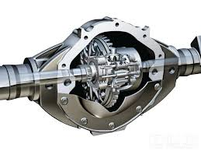
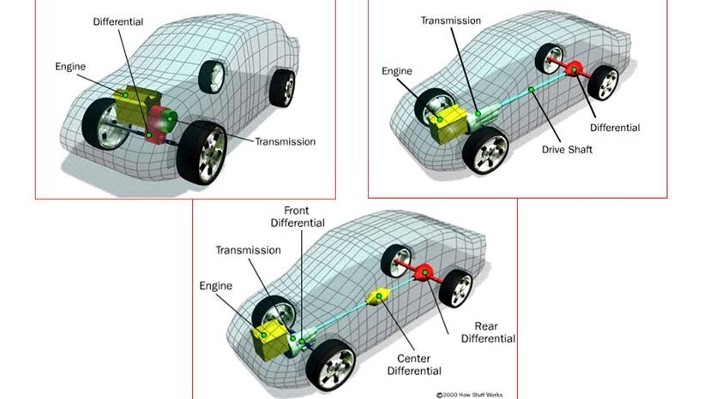
Purdue FSAE – Drivetrain
Sidh Gurnani
08/09/2024

Slide 2
Table of Contents
System Knowledge
Integrating Systems
Boundaries
Goals & Philosophy
Requirements
Architecture
Burndowns
Cost

Slide 3
System Knowledge
PF24, PF20, PF19

Slide 4
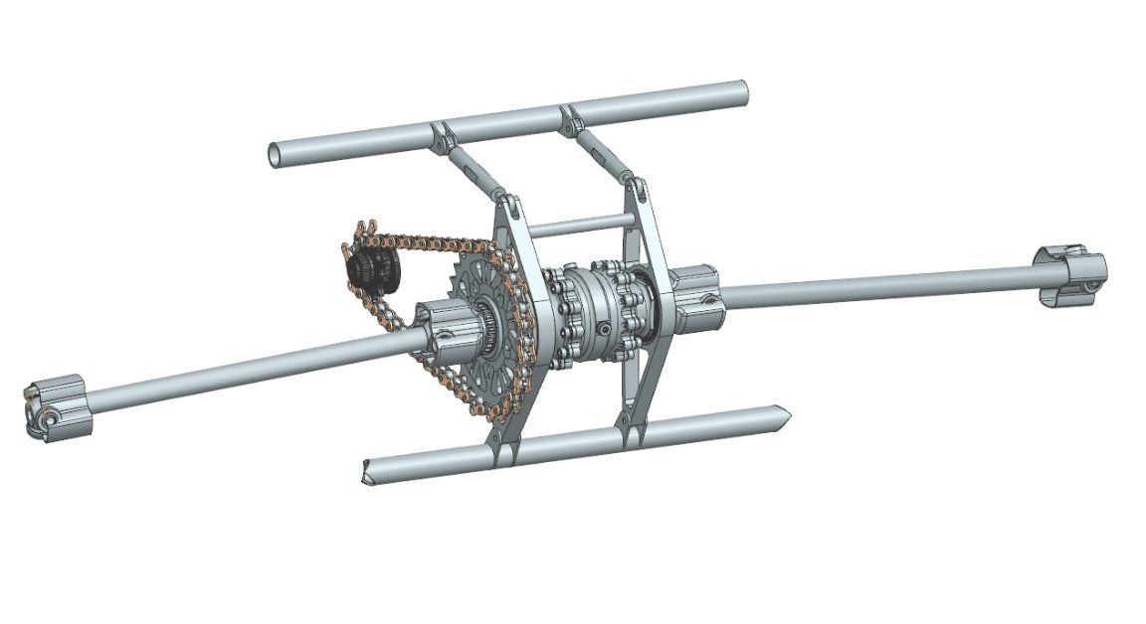
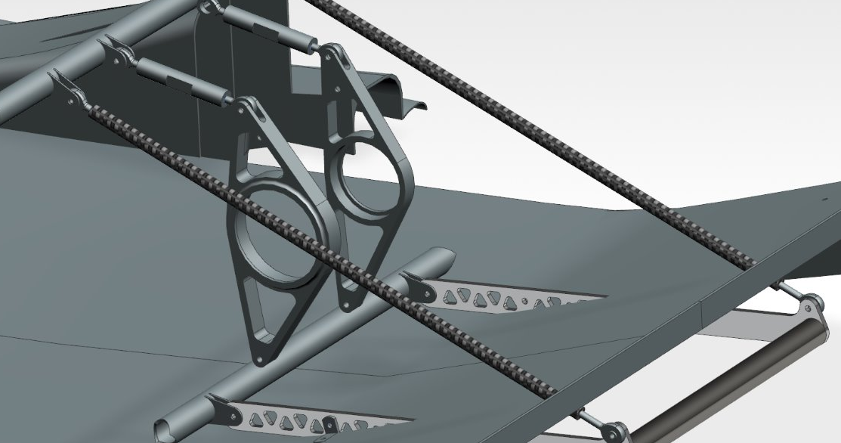
System Knowledge – PF24
Final Drive = 31/12 = 2.58
Turnbuckles
CV Inserts
CV’s (Tripods)
Halfshafts
Front Sprocket
Chain
Rear Sprocket
Differential Carriers
Differential
Chain Guard (not pictured)
Inboard Tripod Housing (Tulips)
Towbar
Boots (not pictured)
1
5
11
10
3
4
9
13
6
2
7
8
12
Notes:
Final Drive Ratio is as was DESIGNED during design season. Reality is that yes, we have to slightly adjust this to be able to launch the car for fall testing purposes.

Slide 5
System Knowledge – PF24
Component | Purchased/Custom | Details/Notes/Info
Rear Sprocket | Custom | Mass: 0.447 lbm 31 teeth Material: Al 7055
Differential Carriers | Custom | Total Mass: 0.95 lbm Material: Al 7055
CV Inserts | Custom | Ran PF20's CV Insert design; changes were made as necessary based on revalidation carried out in FEA with updated loads Material: 17-4 Prehard Stainless Steel (H900)
Towbar (was drivetrain at one point) | Custom | Chassis Mounted Carbon Tubes + Rod Ends Material: Al
Pushbar | Custom | Ran older pushbar
Differential | Purchased | Drexler Salisbury Nonadjustable Limited Slip Differential To my knowledge, used manufacturer's tune
Notes:
Final Drive Ratio is as was DESIGNED during design season. Reality is that yes, we have to slightly adjust this to be able to launch the car for fall testing purposes.

Slide 6
System Knowledge – PF24
Component | Purchased/Custom | Details/Notes/Info
Turnbuckles | Custom | Linear chain tensioning system Material: Al Purchased Rod Ends
Halfshafts | Purchased | RCV Material: 4130 Steel
CV Tripods | Purchased | RCV Material: 4340 Steel
Inboard CV's Housing (Tulips) | Purchased | RCV
Boots | Custom/Purchased | Initially purchased (rubber) Later ran custom (sewed up rubber gloves)
Chain Guard | Custom | Majority of rules related to drivetrain apply here Material: Steel + OEM Ran OEM front and custom steel rear
Chain | Purchased | DID 520 Roller Chain
Notes:
Final Drive Ratio is as was DESIGNED during design season. Reality is that yes, we have to slightly adjust this to be able to launch the car for fall testing purposes.

Slide 7
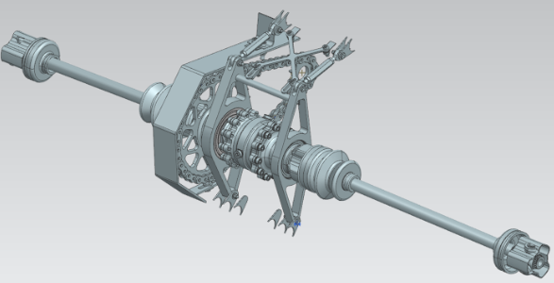
System Knowledge – PF20
Final Drive = 34/11 = 3.09
Architecture and philosophy between PF24 and PF20 very similar
Similar architecture ran for 5 seasons (PF20-24)
Differences:
Higher FDR compared to PF24
Slight design differences

Slide 8

System Knowledge – PF19
Final Drive = 34/11 = 3.09
Chain Tensioning System
CV Inserts
CV’s (Tripods)
Halfshafts
Front Sprocket
Chain
Rear Sprocket
Differential Carriers
Differential
Chain Guard
Inboard Tripod Housing (Tulips)
Towbar
Boots
3
10
1
5
7
6
4
12
2
11
8
9
13

Slide 9
System Knowledge – PF19
Component | Purchased/Custom | Details/Notes/Info
Rear Sprocket | Custom | Unidirectional Material: Al 7055 Mass: 0.503 lbm (slightly heavier than PF24)
Differential Carriers | Custom | Features a more extreme "boomerang" shape than in PF24, PF23 Material: Al 7055 Upleft Mass: 0.721 lbm Upright Mass: 0.244 lbm
CV Inserts | - | -
Towbar | Custom | Integrated with the undertray to get rid of steel support frames found on PF18 Mounted on Diff Carriers
Differential | Purchased | Drexler Salisbury Limited Slip Differential Ramp Angle Settings: Accel 60%, Decel 29%
Chain Tensioning System | Custom | Idler Sprocket with Custom Al Bracket Adjustable mount (to adjust chain tension)

Slide 10
System Knowledge – PF19
Component | Purchased/Custom | Details/Notes/Info
Halfshafts | Purchased | Taylor Race (most likely) Material: Gun Drilled 4130 Steel
CV Tripods | Purchased | Taylor Race (assumption based on above) Material: Steel
Inboard CV's Housing (Tulips) | Purchased | Taylor Race / RCV
Boots | Custom | Material: 3D Printed TPU Goal was to achieve a better fit with interfacing components
Chain Guard | Custom | Material: Steel According to image referenced, ran a steel only configuration, but could have changed to what was ran
Chain | Purchased | DID 520 Roller Chain

Slide 11
Integrating Systems

Slide 12
Integrating Systems
POW > Engine
Function:
Provides the necessary power required to drive the car forward
Engine drives the front sprocket, which interfaces with drivetrain
Four stroke (Intake, Compression, Power, Exhaust)
Drivetrain system has to efficiently, reliably, and safely transmit the power coming from the engine and convert it to usable wheel speed
Contact: Hugh
AERO > Rear Wing
Function:
Redirect airflow headed towards the back of the car upwards to create a reactionary downward force at the rear (downforce)
Pushbar design must not interfere with the rear wing
Contact: Ian

Slide 13
Integrating Systems
AERO > Undertray
Function:
Generate downforce for the overall vehicle by using Venturi tunnels (ground effect)
Undertray, to an extent, dictates the sizing of the overall drivetrain subsystem
Drivetrain system must have clearance to the undertray
If towbar comes back to drivetrain, then have to ensure that towbar placement does not negatively affect AERO while being rules compliant
Contact: Ian, Julia

Slide 14
Integrating Systems
CHA > Frame
Function:
Acts as mounting point for all components on the car
Frame stiffness and component placement on the frame, affects vehicle handling
Frame design dictates placement of the differential axis, which affects drivetrain component placement and respective mounting points
Contact: Dien
SUS > Hubs
Function:
Connection between the wheels and the CV’s
Allows the wheels to spin and turn freely
CV Insert design will drive hub design, and can have affect on CV-Halfshaft and Hubs architecture
Contact: Simon

Slide 15
Integrating Systems
How does drivetrain make it back to tires?
Front sprocket → Chain → Rear Sprocket → Differential → Inboard CV’s → Halfshafts → Outboard CV’s → Hubs → Tires

Slide 16
Boundaries

Slide 17
Boundaries
Suspension
Two sets because final architectural decisions have to be made:
Wheel Hubs/CV Inserts
Wheel Hubs + CV Insert Solution/CV’s (Tripods)
Aero
Rear Wing/Pushbar
Aero responsible for Towbar on PF25 (as of June 2024)
Chassis
Mounting of Driveline(Frame)/Tabs (i.e. for Uprights, Chain Guard, etc)
Powertrain
Engine/Front Sprocket (Mounting, Selection, etc)
Green text indicates responsibility of drivetrain

Slide 18
Requirements

Slide 19
Requirements
Problem Statement: Efficiently transmit power from engine to wheels by optimizing FDR, and subsequently performance in dynamic events and keeping system mass as low as possible, while ensuring safe and reliable operation.
At the minimum, system must be compliant with all relevant rules, specifically related to chain guard, pushbar, critical fasteners, and potentially jacking point.
Jacking point rules are not compiled in this document. Reference FSAE rules for information related to jacking point.

Slide 20
Requirements
Rule | Exact Text | Requirements From Rule
T.5.1 | Any transmission and drivetrain may be used. | Any configuration can be used as team sees fit. Must comply with rest of rules below.
T.5.2.1 | Exposed high speed final drivetrain equipment such as Continuously Variable Transmissions (CVTs), sprockets, gears, pulleys, torque converters, clutches, belt drives, clutch drives and electric motors, must be fitted with scatter shields intended to contain drivetrain parts in case of radial failure. | Drivetrain system must contain "shield" (i.e. Chain Guard) to prevent exposed parts from scattering (i.e. Sprocket, Chain).

Slide 21
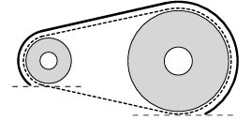
Requirements
Rule | Exact Text | Requirements From Rule
T.5.2.2 | The final drivetrain shield must: a. Be made with solid material (not perforated) b. Cover the chain or belt from the drive sprocket to the driven sprocket/chain wheel/belt or pulley c. Start and end no higher than parallel to the lowest point of the chain wheel/belt/pulley d. Cover the bottom of the chain or belt or rotating component when fuel, brake lines T.3.1.8, control, pressurized, electrical components are located below | Final guard must be made of a solid material and cover the sprocket-chain system as shown in the image.
T.5.2.3 | Body panels or other existing covers are acceptable when constructed per T.5.2.7 / T.5.2.8. | Body panels can be used as part of the guard system if constructed to rules specification.
T.5.2.4 | Frame Members or existing components that exceed the scatter shield material requirements may be used as part of the shield. | Existing frame members and/or components can be used as long as they EXCEED material requirements

Slide 22
Requirements
Rule | Exact Text | Requirements From Rule
T.5.2.5 | Scatter shields may be composed of multiple pieces. Any gaps must be small (< 3 mm). | Guard system can be made of multiple components if gaps are small (i.e. less than 3 mm).
T.5.2.6 | If equipped, the engine drive sprocket cover may be used as part of the scatter shield system. | OEM guards can be used.
T.5.2.7 | Chain Drive - Scatter shields for chains must: a. Be made of 2.66 mm (0.105 inch) minimum thickness steel (no alternatives are allowed) b. Have a minimum width equal to three times the width of the chain c. Be centered on the center line of the chain d. Stay aligned with the chain under all conditions | For chain driven systems (what we historically run), the following must be met: Made of 0.105 inch minimum thick steel Overall width equal to 3 times width of chain Centered along center line of chain at all times Stay aligned with chain under all conditions
T.5.2.9 | Attachment Fasteners - All fasteners attaching scatter shields and guards must be 6 mm or 1/4” minimum diameter Critical Fasteners, see T.8.2 | All fasteners used in guard system must be in accordance to T.8.2

Slide 23
Requirements
Rule | Exact Text | Requirements From Rule
VE.2.2 | Each vehicle must have a removable device which attaches to the rear of the vehicle that: Allows two people, standing erect behind the vehicle, to push the vehicle around the competition site Is capable of slowing and stopping the forward motion of the vehicle and pulling it rearwards | Car must have a push bar that attaches to rear and: Allows two people to push car around at comp Capable of slowing and stopping forward vehicle motion and pulling it backwards
VE.2.3.1.b | One extinguisher must accompany the vehicle when moved using the push bar | A fire extinguisher must accompany vehicle when moved using push bar
D.2.1.1 | Outside of the Dynamic Area(s), vehicles must be pushed at a normal walking pace using the Push Bar (VE.2.2), with a driver in the cockpit and with another team member walking beside | Vehicle to be pushed around outside of dynamic areas

Slide 24
Requirements
Rule | Exact Text | Requirements From Rule
D.2.1.2.b | The team may move the vehicle with: b. The rear wheels supported on dollies, by push bar mounted wheels | Team may move vehicle with dollies that support the rear wheels
D.2.1.3 | When the Push Bar is attached, the engine must stay off, unless authorized by the officials | Push bar on car = engine off

Slide 25
Requirements
Withstand extreme load cases with an adequate factor of safety, as dictated by team standards with regards to safety
Contain a chain tensioning system to account for approximately 3% of chain stretch due to fatigue throughout the season
Integrate desired final drive that will break traction
Hardware within system will be torque spec’d or safety wired to prevent failure on track (with exact torque spec determined by what hardware is used, mostly NAS 3)
Design to the following boundary conditions while maintaining the aforementioned margins to safety:
Peak engine torque (unknown now due to final analysis of dyno data required and will be made known once that said data is analyzed)
Tire size (unknown now due to final analysis carried out by suspension and will be known once that data is analyzed)
Longtudinal Acceleration (historically done about 1.65G)
Approximate Vehicle Weight (unknown right now due to considerations having to be carried out about what weight to consider for drivers and will be known once that metric is set)
Final Drive Ratio (unknown right now due to lapsim analysis and case studies not fully carried out at the moment, but will be known once that data is analyzed and results are provided)
Notes:
Find alternate word for “accommodate”
Have more requirements that are quantifiable
Manufacturing tolerances are documented, but not measured, so no need to explicitly state as a requirement
Boundary conditions are unknown → explicitly state on slides that it is an UNKNOWN, why it is unknown, and a path to getting that information

Slide 26
Goals

Slide 27
Goals
Vehicle Goals | Subsystem Goals
1) Driver Safety | System components are designed to a factor of safety in accordance to team safety standards.
2) System Reliability | Utilize a front and rear sprocket combination that minimizes wear on sprockets Replace components at the end of their life cycle as needed, which is determined by visual inspection of any wear accumulated. Ensure robustness of system by manufacturing/acquiring an extra set of drivetrain components (most likely, minus halfshafts) with 2 extra chains
3) Maximum Competition Points (Mass, CG, Yaw Inertia…) | Strategically reduce mass to keep system mass as low as possible, while ensuring safety standards are met. Accommodate final drive ratio that allows team to achieve the highest possible competition points in accordance to case studies performed and lapsim
Notes:
With regards to SF → use team standard for that going forward, no reason to go that low and play it safe (will follow up as to why we had run that in the past)
Quantify goals, this slide needs an overhaul tbh… We do not have any documented info on torque specs, so have to either put down numbers or something else
Safety → Hardware is a requirement
Relate sprocket replacement to wear by visual inspection (to other components as well), front rear sprocket combination makes no sense, checking chain tension does not belong
Checking chain tension, can check and stuff, but tracking chain wear and fatigue yields no benefits to reliability and is more of a knowledge thing
Replacement period
Spares not a design goal, but spares will be made (sprocket can be replaced by x, y, z)
Get info on bolts, then can get an idea of a torque spec to use

Slide 28
Goals
Vehicle Goals | Subsystem Goals
4) Driver Confidence/Comfort | No major failures during testing season for any component and mounting mechanisms Find and set up differential for a tune that yields no driver complaints
5) Serviceability | Utilize a chain tensioning system that accounts for: Chain stretch and fatigue throughout the season Easy chain tension adjustments (should occur under 5 minutes) Allow for relatively easy access to hardware by accommodating space for appropriate tools needed for servicing
Notes:
First point on #3 → place it in a bit and rewrite, very outdated and honestly no good
Second point on #3 can be tweaked from a specificity point of view (general comment for entire slide)
Confidence and Comfort → not sure if that is a confidence goal, and especially not good to include as the reliability goals are poorly defined as is
Get rid of manufacturing tolerances, tool access goal should be reworded
Good example is the very last bullet point of what a good bullet point looks like maybe

Slide 29
Architecture

Slide 30
Differential
 | Drexler LSD | Custom Spool | Another Purchased Diff
Team History | Ran by team for several seaons now, and has proven to be a dependable option | Completely new, but team has documented experimentation with designing one | None; this would be a complete experiment to see how it works with our setup
Mass compared to benchmark | ~ 8.8 lbs (benchmark) Assuming V3; dry weight | Significantly lower | Comparitively similar to the benchmark
Tuning | Possible | Not possible | Possible
Implementation | Historical knowledge, can tune as needed to improve handling | Architecture on several systems would have to pivot drastically; negative to driveability | No knowledge, would have to rework a lot of components that have been used in the past
My Verdict
Given considerations that suspension would have to completely pivot design for a gain that may or may not be realizable, it is best to stick with what team has been running for now. This would also allow money to be spent on other parts of the car as required, since a new differential will cost about $3000, and there is no issues with our current differential. Additionally, endcaps are available for purchases for our current set up, which allows for further optimization.
Notes:
Mass numbers are VERY wrong… use manuals and lesson learned to never fully trust an online source again without verification
Research other purchased diffs that can be run and do another tradeoff study if needed

Slide 31
Drexler Limited Slip Differential
 | Nonadjustable (PF24) | Adjustable (PER)
Team History | Ran for several seasons with no major issues | To my knowledge, never ran
Perks | Decent past knowledge | Time saving on adjustments made during initial set up and testing Customizable preload adjustment range Can account for variable race and track condition (more knowledge to do successfully) Relatively compatible to what team has ran historically Allows us to run both an adjustable and non adjustable and swap as needed or wanted
Verdict
Open for discussion; According to service manuals, both have fairly similar components, so nothing drastic changes from a rebuilding and understanding point of view, but running an adjustable allows us to be more efficient with diff tuning if that is something we are willing to explore this year. We have both, so we can set them up and see what works better for our needs and have one diff as a spare. Note that this slide assumes we can sort out the seized bearing issue on PER’s adjustable diff
Notes:
Retrofitted is not a good word to use in this case

Slide 32
Another Purchased Diff
Types of diffs available for use:
Open Differential/Spool
Detroit Locker Differential
Cam and Pawl Differential
Salisbury or Clutch Pack Differential
Automatic Torque Biasing Differential
The preferred differential among many FSAE teams remains a clutch pack differential
Open diff and spool is a negative to driveability
Other differentials are more complex and not well supported for FSAE teams

Slide 33
Rear Sprocket
 | Custom | Purchased
Team History | Ran successfully in the past with no major issues | To my knowledge, never ran
Flexibility | Ability to control design to exactly how it is required (FDR, mass optimization, etc); can also work in a variety of conditions | Extremely restricted selection and application; would have to design around rear sprocket, which is not a good idea
 | Titanium | Aluminum
Mass (benchmark = Al) | Slight weight loss (~0.1 lbm loss) | Benchmark (~0.5 lbm)
Machining Time | Much longer machining time compared to Aluminum + Wire EDM | Took me around 5-7 hrs with about 1-3 hrs of stock prep put in beforehand + Wire EDM
Cost | Significantly Higher | Benchmark
My Verdict
An aluminum custom rear sprocket is best due to the better machining times and the smaller potential weight loss with titanium. In addition, cost would be much higher. Only main benefit of titanium is fatigue life, which can be mitigated by manufacturing spares. An alternate route can be considered by making a Ti sprocket as opposed to multiple spares of Al. The weight loss with rotating mass seems appealing.
Notes:
Rethink verdict
Making one Ti might be better than making 2 Al
Chain could wear using Ti vs using Al
REDO VERDICT

Slide 34
Differential Carriers
 | Titanium | Aluminum
Team History | To my knowledge, not run at least in recent history | Traditionally ran for the last couple of seasons
Mass (benchmark = Al) | Slight weight loss (potentially a bit more than sprocket) | Benchmark
Machining Time | Much longer machining time compared to Aluminum | Benchmark
Cost | Significantly Higher | Benchmark
My Verdict
Given there is not so much gains with respect to mass loss and with the added cost that comes with it, it does not make much sense to pursue titanium. Considering that the design of the differential carriers could get more complex this year (a possibility), it is best to stick with aluminum to reduce machining time and avoid extra costs. Further, there is room to play with optimizing overall system mass by using different endcaps for the differential we have.
Notes:
Too many “benchmarks” here, can add some info about machining time, cost, and ESPECIALLY masses
Redo verdict again
Ticon costs

Slide 35
Chain Tensioning Mechanism
 | Linear Translation (aka Turnbuckles) | Idler Sprocket | Eccentric Differential Carriers
Team History | Ran in recent history since PF20 | Ran once in recent history (PF19) | To my knowledge, never ran by team, but at least not in recent seasons
Mounting | Refer to PF24 CAD | Along length of chain; placement is key since chain guard has to cover idler sprocket | Same location as differential carries along diff axis, except would connect directly to two points on chassis
Manufacturability | Rod ends purchased; Custom body (relatively simple) | Would probably purchase sprocket, but manufacture adjustable mounting mechanism | Most difficult of the bunch to manufacture due to complexity of components
Approx Mass | Benchmark | Very similar, potential to be slightly higher or lower | Heavier
Notes:
Can submit a rules clarification as to whether an idler sprocket has to be covered by a chain guard or not… PF19 didn’t seem to follow that on initial CAD so need to find out
Provide masses when possible; Better weight delta

Slide 36
Chain Tensioning Mechanism
 | Linear Translation (aka Turnbuckles) | Idler Sprocket | Eccentric Differential Carriers
Serviceability | Easy to adjust chain tension with excellent tool access | Relatively simple to adjust chain tension with extra measures needed for easy tool access | Similar to turnbuckles, but adjustment takes place on diff carriers (maybe slight issues with tool access)
Simplicity of Design | Benchmark (simple design and manufacturing) | Adjustable mount has potential to be complicated pending mounting location | Adds complexity to the differential carrier system
Aligns with measures to reduce halfshaft angle | Not really | Yes | Yes
Additional Considerations | One turnbuckle takes about 45 mins to make | Analysis for idler sprocket; to my knowledge, no effect on FDR; have to understand why we stopped running; adds chain length; mounting | If running, have to figure out how to simplify this system as best as possible.
Notes:
Fix serviceability slightly or get rid of that category completely
Priority #1 is figuring out why team stopped running an idler sprocket on PF20 (was run on PF19, not on PF20)

Slide 37
Chain Tensioning Mechanism
My Verdict
The safest option is to stick with turnbuckles, but all three options are here for consideration. Looking at PF25, there is high likelihood to run turnbuckles. If a situation arises in the future where other options can be considered, this is a good place to start.

Slide 38
Halfshafts
 | Custom (Ti) | Purchased (4130 Steel)
Team History | Idea has been talked about before but would have to do a significant amount of work (obtaining high fidelity laser scan, sourcing manufacturing, analysis, etc) | Used for the last several seasons, serves as a dependable option that is structurally sound; Variety of sizes available for purchase and can be machined to final size
Mass (benchmark = purchased) | Can't get an exact amount in terms of mass saved, but increases as the length of halfshaft increases | Benchmark
Machining Time | MUCH longer (and will most likely have to send this out) | Benchmark; comes with spline
Cost | Significantly higher | Benchmark
My Verdict
Open for discussion, but ability to do this will depend on having the full knowledge and the resources necessary at the correct time. Given other changes that will most likely occur, can't be certain yet about making a custom.
Notes:
Find out any downsides for manufacturability of halfshafts from Aarnav
Redo verdict

Slide 39
CV Inserts
 | Reiteration / Revalidation on PF24's Design | New Design / Purchased
Team History | Ran in the last couple of seasons since PF20; No notable issues to my knowledge | Not run in recent history
Change to recent hubs design philosophy | Zero change | Would be a change depending on design
 | 17-4 Prehard Stainless w H900 Heat Treatment | Another Material with Appropriate Hardness
Team History | Ran on PF24 | Not ran on PF24
Manufacturing | Cut to length, HT in ME, Wire EDM | Would look similar to 17-4, might have to HT to a different specification
My Verdict
Open for discussion. The safe option is running with 17-4PH as it gives the desired hardness value (around 55 HRC) and uses H900 to avoid an HT that would make the part brittle (i.e. H1000)
Notes:
Slide is open ended, will probably change drastically by the time I have that discussion about running CV Inserts or not

Slide 40
Boots
 | Purchased | Custom (Nitrile Glove Special) | Custom (3D Printed)
Team History | Typically ran in recent seasons | Ran on PF24 after purchased boots failed | Ran at least once in recent history (PF19)
Cost | ~$12 for 1 | ~$5 for 2 | Filament dependent
Other considerations | Have to fully understand why it failed last year to be able to conclusively say if this was a failure or not | Doesn't take long to make, but definitely has the appearance of a lower fidelity prototype | Can be made to exact specifications based on the design; Is also something else that has to be designed and manufactured
My Verdict
Open for discussion, and something that can be changed down the line if necessary (including during testing season if required).

Slide 41
Other Components
Component | Notes
Chain Guard | Custom Steel by rules and manufactured in house
Chain | Purchased DID 520 Roller Chain
Inboard CV Housing (Tulips) | Purchased – Diff Custom – Spool
CV's (Tripods) | Purchased (RCV)

Slide 42
Burndowns

Slide 43
System Burndown
Initial Drivetrain Architecture and Design Considerations
SUS Points, Rear CHA box, Initial driveline placement, Initial Halfshaft Angles
Drivetrain DCR
Finalize Architecture
Initial Calculations and Analysis
Initial FEA
Initial CAD
Drivetrain PDR
Final Calculations and Analysis
IDR
Final FEA
Final CAD
Drivetrain CDR
Source Stock + Purchased Parts
Manufacturing
Assembly
Testing
Pushbar design and manufacturing
Click for Detailed Burndown

Slide 44
Cost

Slide 45
Cost
Major Component | Owned/Sponsored/Purchased | Estimated Cost + Misc Notes
Drexler Salisbury LSD | Owned | $3000
Halfshafts | Purchased | $300 x 2
Tripods | Purchased | $115 x 4
Diff Carrier Bearings | Sponsored (SKF, NTN) | $150 x 4
Inboard CV (Tulip) Housings | Owned | $750
Aluminum Stock | Sponsored (Arconic) | $1000
Chain | Purchased | $100 x 2-3
Hardware | Purchased | $250
Total Estimated Cost (excluding owned and sponsored parts) | $1610
Note that is an estimate and will likely go up depending on final architecture and material selection. Based heavily off of PF24 architecture.

Slide 46
Appendix A: Basics of an Idler Sprocket

Slide 47
Idler Sprocket Basics
An idler sprocket is a smaller sprocket that is placed along the length of the chain to allow the chain to maintain constant tension.
Chain too loose → risk chain falling out of place and could cause injury
Chain too tight → excessive wear on sprockets and chains, which requires replacement more often
Should be installed on the slack side of the chain
Usually the length of the chain that runs closer to the bottom for our purposes
Loading, chain wrap, and chain speed are important to consider
A chain rider is an alternative that functions similarly to an idler sprocket (no teeth to worry about, but radial loading still a factor)

Slide 48
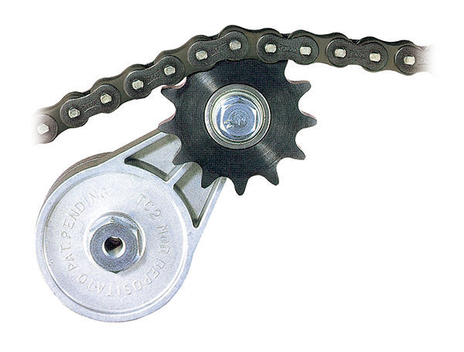
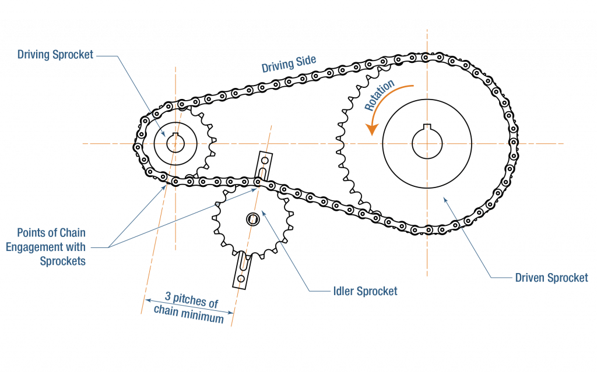
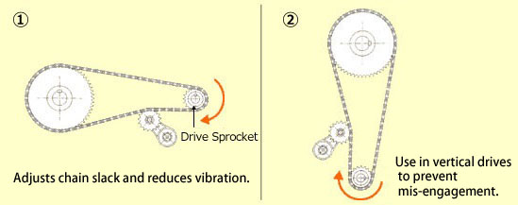
Reference Images

Slide 49
Appendix B: Preliminary Halfshaft Length/Diff Endcap Weight Study

Slide 50
Halfshaft Length/Diff Endcap Study
General Note: Longer endcap will reduce weight of halfshafts, but increase the weight of diff. However, halfshaft angles will also go up (further compounded by chain stretch), which makes minimizing initial halfshaft angle extremely crucial.
Nominal Halfshaft Length | Weight
11” | 1.02 lbm
13” | 1.19 lbm
15” | 1.36 lbm
17” | 1.54 lbm
19” | 1.71 lbm
21” | 1.88 lbm
23” | 2.06 lbm
Assumption: we will be running a halfshaft length close to a nominal length.
We will save 0.17 lbm for every 2 inch reduction.
Source for Weights: RCV FSAE Axle Shaft - FSAEparts.com

Slide 51
Halfshaft Length/Diff Endcap Study
Below is data compiled for non adjustable diff. Adjustable should yield relatively similar results.
PF24 ran a bearing spacing of approx 140mm (136mm on calcs). Loads deltas are sourced from PF24 differential carriers hand calculations.
Quick note: weights are not super well documented online. These weights are taken from service manual and is not clear whether it accounts for one or both endcaps. I’m running with assumption that it accounts for both.
PF24 Diff Carrier Masses (approx.):
Left → 0.61 lbm
Right → 0.356 lbm
Differential Cover Version | Bearing Spacing | Weight (endcaps only!) | Left Diff Carrier Loads (relative to PF24) | Right Diff Carrier Loads (relative to PF24)
V1 | 120mm | 0.480 lbm | +2.644% | +12.698%
V2 | 140mm | 0.597 lbm | +/- 0% | +/- 0%
V3 | 160mm | 0.730 lbm | -2.99% | -16.108%
Notes:
We might have ran V1 instead of V2, so this table is pretty much useless ☺

Slide 52
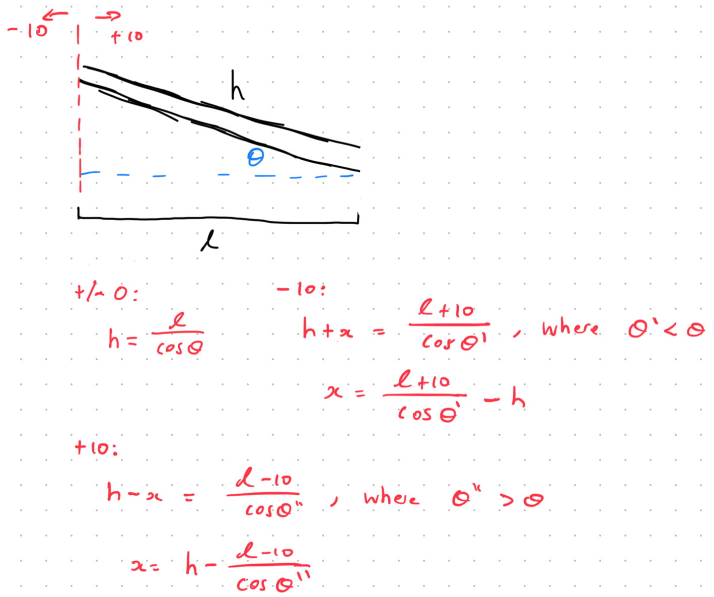
Halfshaft Length/Diff Endcap Study
Concluding Remarks:
Possibility that differential carriers can be mass optimized to reduce mass to potentially offset the gain that a larger bearing spacing would bring
Biggest gain to me seems to be the halfshaft weight saving

Slide 53
Appendix C: PF24 BOM

Slide 54
PF24 BOM (Drivetrain Only)
Subsytem | Vendor | Link | Item Code | Description | Quantity | Cost Per Unit [$] | Estimated Total Cost [$] | Shipping Cost [$] | Discount [%] | Total Cost With Discount [$]
Drivetrain | RCV Performance | RCV FSAE Axle Shaft - 11" (rcvperformance.com) |  | Halfshafts | 2 | $286.00 | $572.00 | $0.00 | 0% | $572.00
Drivetrain | RCV Performance |  |  | Tripods | 4 | $115.50 | $462.00 | $0.00 | 0% | $462.00
Drivetrain | NTN/SKF |  |  | 61910 2RS1 | 2 | $150.00 | $300.00 | $0.00 | 100% | $0.00
Drivetrain | NTN/SKF |  |  | 6011 2RS1 | 2 | $150.00 | $300.00 | $0.00 | 100% | $0.00
Drivetrain | Motion Industies | Aurora Bearing Company XAM-3T MALE ROD END ALLOY - Motion |  | XAM 3T Rod Ends | 4 | $60.00 | $240.00 | $0.00 | 0% | $240.00
Drivetrain | Bearing Dist Inc | XAB-3T - AURORA BEARING | Spherical Plain Bearings - Rod Ends | BDI USA (bdiexpress.com) |  | XAB 3B Rod Ends | 4 | $52.00 | $208.00 | $0.00 | 0% | $208.00
Drivetrain | McMaster | Tight-Tolerance High-Strength 7075 Aluminum Rod, 5/8" Diameter | McMaster-Carr |  | 5/8 Round 1ft 7075 | 1 | $41.78 | $41.78 | $0.00 | 0% | $41.78
Drivetrain | McMaster | Multipurpose 6061 Aluminum, 3/16" Thick x 4" Wide | McMaster-Carr |  | Sheet for Towbussy | 2 | $28.43 | $56.86 | $0.00 | 0% | $56.86
Drivetrain | McMaster | General Purpose Aluminum Tubing, 1" OD, 0.083" Wall Thickness | McMaster-Carr |  | Towbussy Tubeussy | 2 | $17.37 | $34.74 | $0.00 | 0% | $34.74
Drivetrain | McMaster | Ball Joint Rod End, 10-32 Thread | McMaster-Carr |  | Carbon Tube Rod Ends | 4 | $4.40 | $17.60 | $0.00 | 0% | $17.60
Drivetrain | McMaster | Low-Strength Steel Hex Nut, Zinc-Plated, 10-32 Thread Size | McMaster-Carr |  | 10-32 Nuts | 200 | $0.02 | $4.40 | $0.00 | 0% | $4.40
Drivetrain | McMaster | Medium-Strength Steel Hex Nut, Grade 5, Zinc-Plated, 1/4"-28 Thread Size | McMaster-Carr |  | 1/4-28 Nuts | 100 | $0.08 | $8.00 | $0.00 | 0% | $8.00
Drivetrain | Rockwest Composites | Rockwest Tubes (Some aero stuff Ill ask Joe when I get a chance smh) |  | Towbar Tubes | 2 | $100.00 | $200.00 | $0.00 | 100% | $0.00
Drivetrain | Drexler |  |  | Differential | 1 | $2,500.00 | $2,500.00 | $0.00 | 100% | $0.00
Drivetrain | Drexler |  |  | Short Tripod | 1 | $300.00 | $300.00 | $0.00 | 100% | $0.00
Drivetrain | Drexler |  |  | Long Tripod | 1 | $350.00 | $350.00 | $0.00 | 100% | $0.00
Drivetrain | ALRO | ALRO |  | 17-4 PH 3in Round | 1 | $350.00 | $350.00 | $0.00 | 100% | $0.00
Drivetrain | Arconic |  |  | 7055 Aluminum 4 in thick blocks | 4 | $250.00 | $1,000.00 | $0.00 | 100% | $0.00

